Slide 1
Bayesian Statistics
Made Simple
Allen B. Downey
Olin College
sites.google.com/site/simplebayes

Slide 2
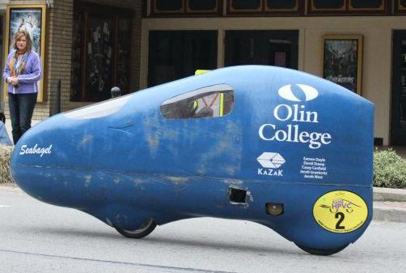

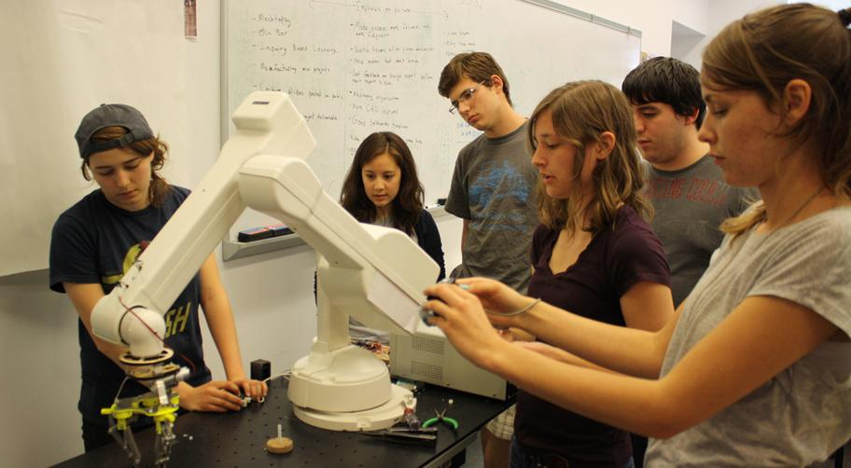


Slide 3
Follow along at home
sites.google.com/site/simplebayes

Slide 4
The plan
From Bayes's Theorem to Bayesian inference.
A computational framework.
Work on example problems.

Slide 5
Goals
By the end, you should be ready to:
Work on similar problems.
Learn more on your own.

Slide 6
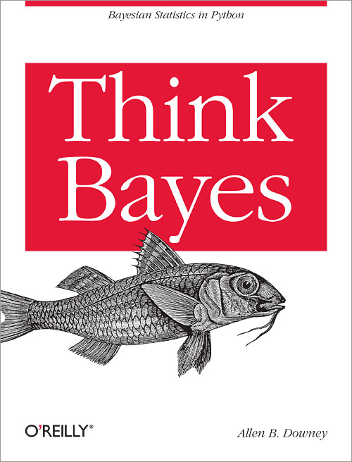
Think Bayes
This tutorial is based on my book,
Think Bayes
Bayesian Statistics in Python
Published by O'Reilly Media
and available under a
Creative Commons license from
thinkbayes.com

Slide 7
Probability
p(A): the probability that A occurs.
p(A|B): the probability that A occurs, given that B has occurred.
p(A and B) = p(A) p(B|A)

Slide 8
Bayes's Theorem
By definition of conjoint probability:
p(A and B) = p(A) p(B|A) = (1)
p(B and A) = p(B) p(A|B)
Equate the right hand sides
p(B) p(A|B) = p(A) p(B|A) (2)
Divide by p(B) and ...

Slide 9

Bayes's Theorem

Slide 10
Bayes's Theorem
One way to think about it:
Bayes's Theorem is an algorithm to get
from p(B|A) to p(A|B).
Useful if p(B|A), p(A) and p(B) are easier
than p(A|B).
OR ...

Slide 11
Diachronic interpretation
H: Hypothesis
D: Data
Given p(H), the probability of the hypothesis before you saw the data.
Find p(H|D), the probability of the hypothesis after you saw the data.

Slide 12
A cookie problem
from Wikipedia
Suppose there are two bowls of cookies.
Bowl #1 has 10 chocolate and 30 vanilla.
Bowl #2 has 20 of each.
Fred picks a bowl at random, and then picks a cookie at random. The cookie turns out to be vanilla.
What is the probability that Fred picked from Bowl #1?

Slide 13
Cookie problem
H: Hypothesis that cookie came from Bowl 1.
D: Cookie is vanilla.
Given p(H), the probability of the hypothesis before you saw the data.
Find p(H|D), the probability of the hypothesis after you saw the data.

Slide 14
Diachronic interpretation
p(H|D) = p(H) p(D|H) / p(D)
p(H): prior
p(D|H): conditional likelihood of the data
p(D): total likelihood of the data

Slide 15
Diachronic interpretation
p(H|D) = p(H) p(D|H) / p(D)
p(H): prior = 1/2
p(D|H): conditional likelihood of the data = 3/4
p(D): total likelihood of the data = 5/8

Slide 16
Diachronic interpretation
p(H|D) = (1/2)(3/4) / (5/8) = 3/5
p(H): prior = 1/2
p(D|H): conditional likelihood of the data = 3/4
p(D): total likelihood of the data = 5/8

Slide 17
A little intuition
p(H): prior = 50%
p(H|D): posterior = 60%
Vanilla cookie was more likely under H.
Slightly increases our degree of belief in H.

Slide 18
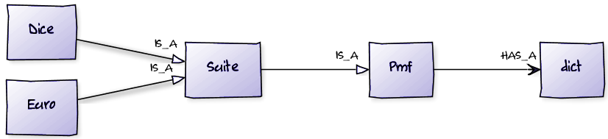
Computation
Pmf represents a Probability Mass Function
Maps from possible values to probabilities.
Diagram by yuml.me

Slide 19
Install test
How many of you got install_test.py running?
Don't try to fix it now!
Instead...

Slide 20
Partner up
If you don't have a working environment, find a neighbor who does.
Even if you do, try pair programming!
Take a minute to introduce yourself.
Questions? Ask your partner first (please).

Slide 21
Icebreaker
What was your first computer?
What was your first programming language?
What is the longest time you have spent finding a stupid bug?

Slide 22
Start your engines
You cloned BayesMadeSimple, right?
cd into that directory.
Start the Python interpreter.
$ python
>>> from thinkbayes import Pmf

Slide 23
Or IPython
cd into BayesMadeSimple.
Start IPython.
Create a new notebook.
$ ipython notebook --matplotlib inline
from thinkbayes import Pmf

Slide 24
Pmf
from thinkbayes import Pmf
# make an empty Pmf
d6 = Pmf()
# outcomes of a six-sided die
for x in [1,2,3,4,5,6]:
d6.Set(x, 1)

Slide 25
Pmf
d6.Print()
d6.Normalize()
d6.Print()
d6.Random()

Slide 26

Style
I know what you're thinking.

Slide 27
The Bayesian framework
1) Build a Pmf that maps from each hypothesis to a prior probability, p(H).
2) Multiply each prior probability by the likelihood of the data, p(D|H).
3) Normalize, which divides through by the total likelihood, p(D).

Slide 28
Prior
pmf = Pmf()
pmf.Set('Bowl 1', 0.5)
pmf.Set('Bowl 2', 0.5)

Slide 29
Update
p(Vanilla | Bowl 1) = 30/40
p(Vanilla | Bowl 2) = 20/40
pmf.Mult('Bowl 1', 0.75)
pmf.Mult('Bowl 2', 0.5)

Slide 30
Normalize
pmf.Normalize()
0.625 # return value is p(D)
print pmf.Prob('Bowl 1')
0.6

Slide 31
Exercise
What if we select another cookie, and it’s chocolate?
The posterior (after the first cookie) becomes the prior (before the second cookie).

Slide 32
Exercise
What if we select another cookie, and it’s chocolate?
pmf.Mult('Bowl 1', 0.25)
pmf.Mult('Bowl 2', 0.5)
pmf.Normalize()
pmf.Print()
Bowl 1 0.43 Bowl 2 0.573

Slide 33

Summary
Bayes's Theorem,
Cookie problem,
Pmf class.

Slide 34
The dice problem
I have a box of dice that contains a 4-sided die, a 6-sided die, an 8-sided die, a 12-sided die and a 20-sided die.
Suppose I select a die from the box at random, roll it, and get a 6. What is the probability that I rolled each die?

Slide 35
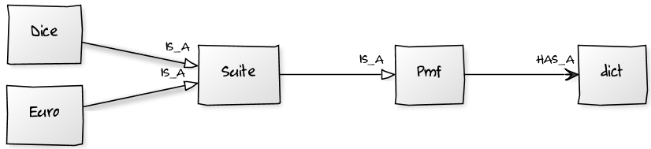
Hypothesis suites
A suite is a mutually exclusive and collectively exhaustive set of hypotheses.
Represented by a Suite that maps
hypothesis → probability.

Slide 36
Suite
class Suite(Pmf):
"Represents a suite of hypotheses and
their probabilities."
def __init__(self, hypos):
"Initializes the distribution."
for hypo in hypos:
self.Set(hypo, 1)
self.Normalize()

Slide 37
Suite
def Update(self, data):
"Updates the suite based on data."
for hypo in self.Values(): like = self.Likelihood(data, hypo) self.Mult(hypo, like)
self.Normalize()
self.Likelihood?

Slide 38
Suite
Likelihood is an abstract method.
Child classes inherit Update,
provide Likelihood.

Slide 39
Likelihood
Outcome: 6
What is the likelihood of this outcome on a six-sided die?
On a ten-sided die?
On a four-sided die?
What is the likelihood of getting n on an m-sided die?

Slide 40
Likelihood
# hypo is the number of sides on the die
# data is the outcome
class Dice(Suite):
def Likelihood(self, data, hypo): # write this method!
Write your solution in dice.py

Slide 41
Likelihood
# hypo is the number of sides on the die
# data is the outcome
class Dice(Suite):
def Likelihood(self, data, hypo): if hypo < data: return 0 else: return 1.0/hypo

Slide 42
Dice
# start with equal priors
suite = Dice([4, 6, 8, 12, 20])
# update with the data
suite.Update(6)
suite.Print()

Slide 43
Dice
Posterior distribution:
4 0.0
6 0.39
8 0.30
12 0.19
20 0.12
More data? No problem...

Slide 44
Dice
for roll in [8, 7, 7, 5, 4]:
suite.Update(roll)
suite.Print()

Slide 45
Dice
Posterior distribution:
4 0.0
6 0.0
8 0.92
12 0.080
20 0.0038

Slide 46

Summary
Dice problem,
Likelihood function,
Suite class.

Slide 47

Recess!
http://ksdcitizens.org/wp-content/uploads/2010/09/recess_time.jpg

Slide 48
Trains
The trainspotting problem:
You believe that a freight carrier operates between 100 and 1000 locomotives with consecutive serial numbers.
You spot locomotive #321.
How many locomotives does the carrier operate?
Modify train.py to compute your answer.

Slide 49
Trains
If there are m trains, what is the chance of spotting train #n?
What does the posterior distribution look like?
How would you summarize it?

Slide 50
Train
print suite.Mean()
print suite.MaximumLikelihood() print suite.CredibleInterval(90)

Slide 51
Trains
What if we spot more trains?
Why did we do this example?

Slide 52
Trains
Practice using the Bayesian framework, and figuring out Likelihood().
Example that uses sparse data.
It’s a non-trivial, real problem.

Slide 53
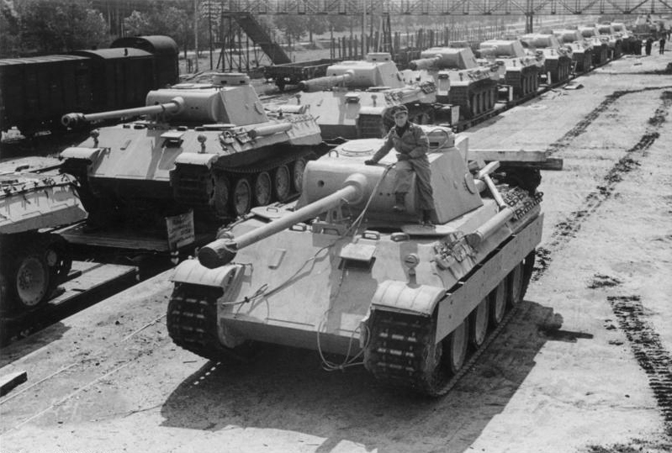
Tanks
The German tank problem.
http://en.wikipedia.org/wiki/German_tank_problem

Slide 54
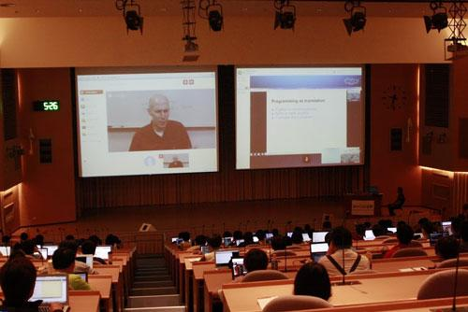
Good time for questions

Slide 55
A Euro problem
"When spun on edge 250 times, a Belgian one-euro coin came up heads 140 times and tails 110. 'It looks very suspicious to me,' said Barry Blight, a statistics lecturer at the London School of Economics. 'If the coin were unbiased, the chance of getting a result as extreme as that would be less than 7%.' "
From "The Guardian" quoted by MacKay, Information Theory, Inference, and Learning Algorithms.

Slide 56
A Euro problem
MacKay asks, "But do these data give evidence that the coin is biased rather than fair?"
Assume that the coin has probability x of landing heads.
(Forget that x is a probability; just think of it as a physical characteristic.)

Slide 57
A Euro problem
Estimation: Based on the data (140 heads, 110 tails), what is x?
Hypothesis testing: What is the probability that the coin is fair?

Slide 58
Euro
We can use the Suite template again.
We just have to figure out the likelihood function.

Slide 59
Likelihood
# hypo is the prob of heads (1-100)
# data is a string, either 'H' or 'T'
class Euro(Suite): def Likelihood(self, data, hypo): # one more, please!
Modify euro.py to compute your answer.

Slide 60
Likelihood
# hypo is the prob of heads (1-100)
# data is a string, either 'H' or 'T'
class Euro(Suite): def Likelihood(self, data, hypo): x = hypo / 100.0 if data == 'H': return x else: return 1-x

Slide 61
Prior
What do we believe about x before seeing the data?
Start with something simple; we'll come back and review.
Uniform prior: any value of x between 0% and 100% is equally likely.

Slide 62
Prior
suite = Euro(range(0, 101))

Slide 63
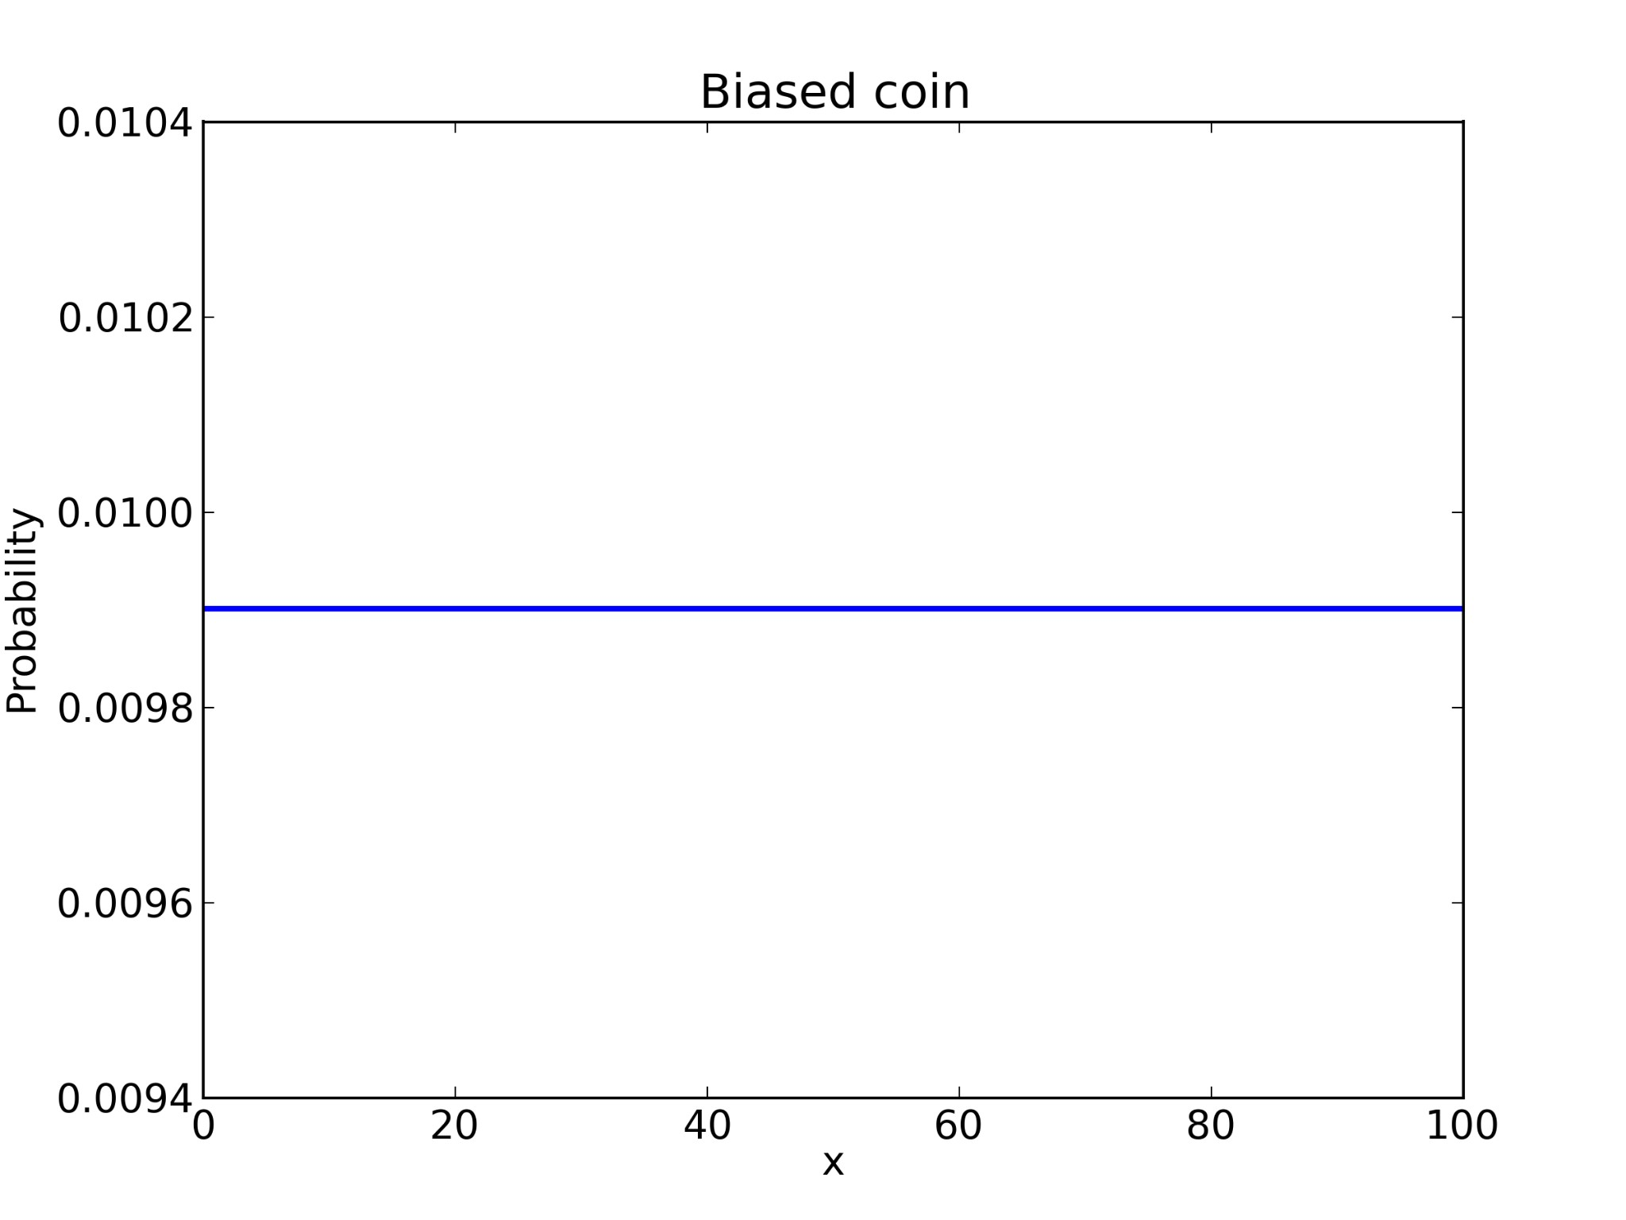

Slide 64
Update
Suppose we spin the coin once and get heads.
suite.Update('H')
What does the posterior distribution look like?
Hint: what is p(x=0% | D)?

Slide 65
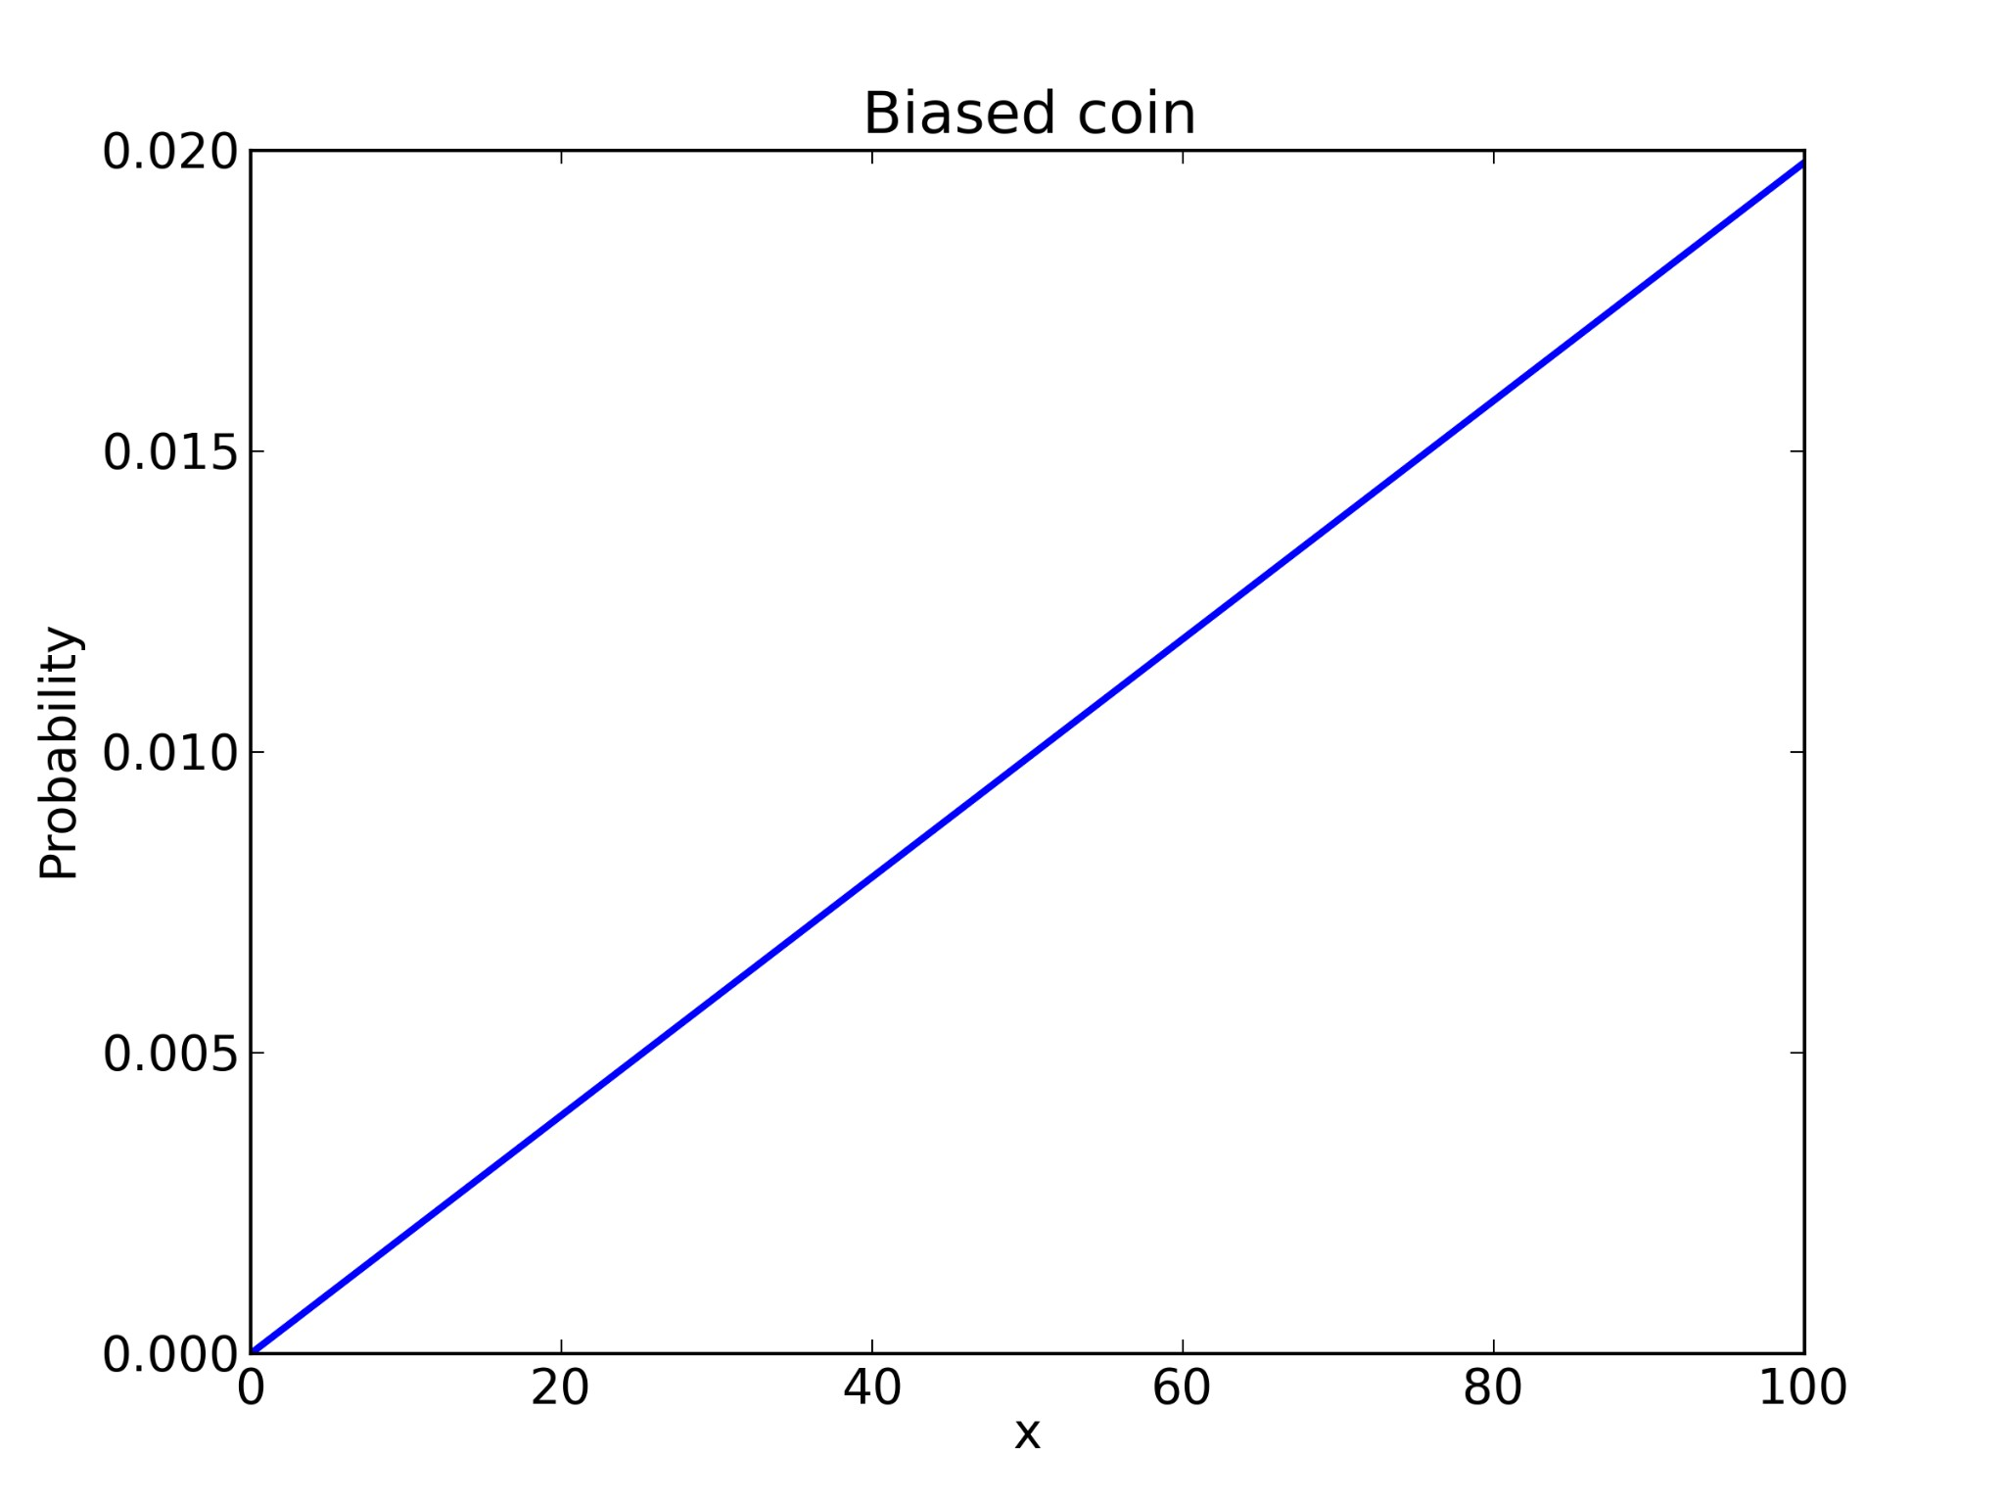

Slide 66
Update
Suppose we spin the coin again, and get heads again.
suite.Update('H')
What does the posterior distribution look like?

Slide 67
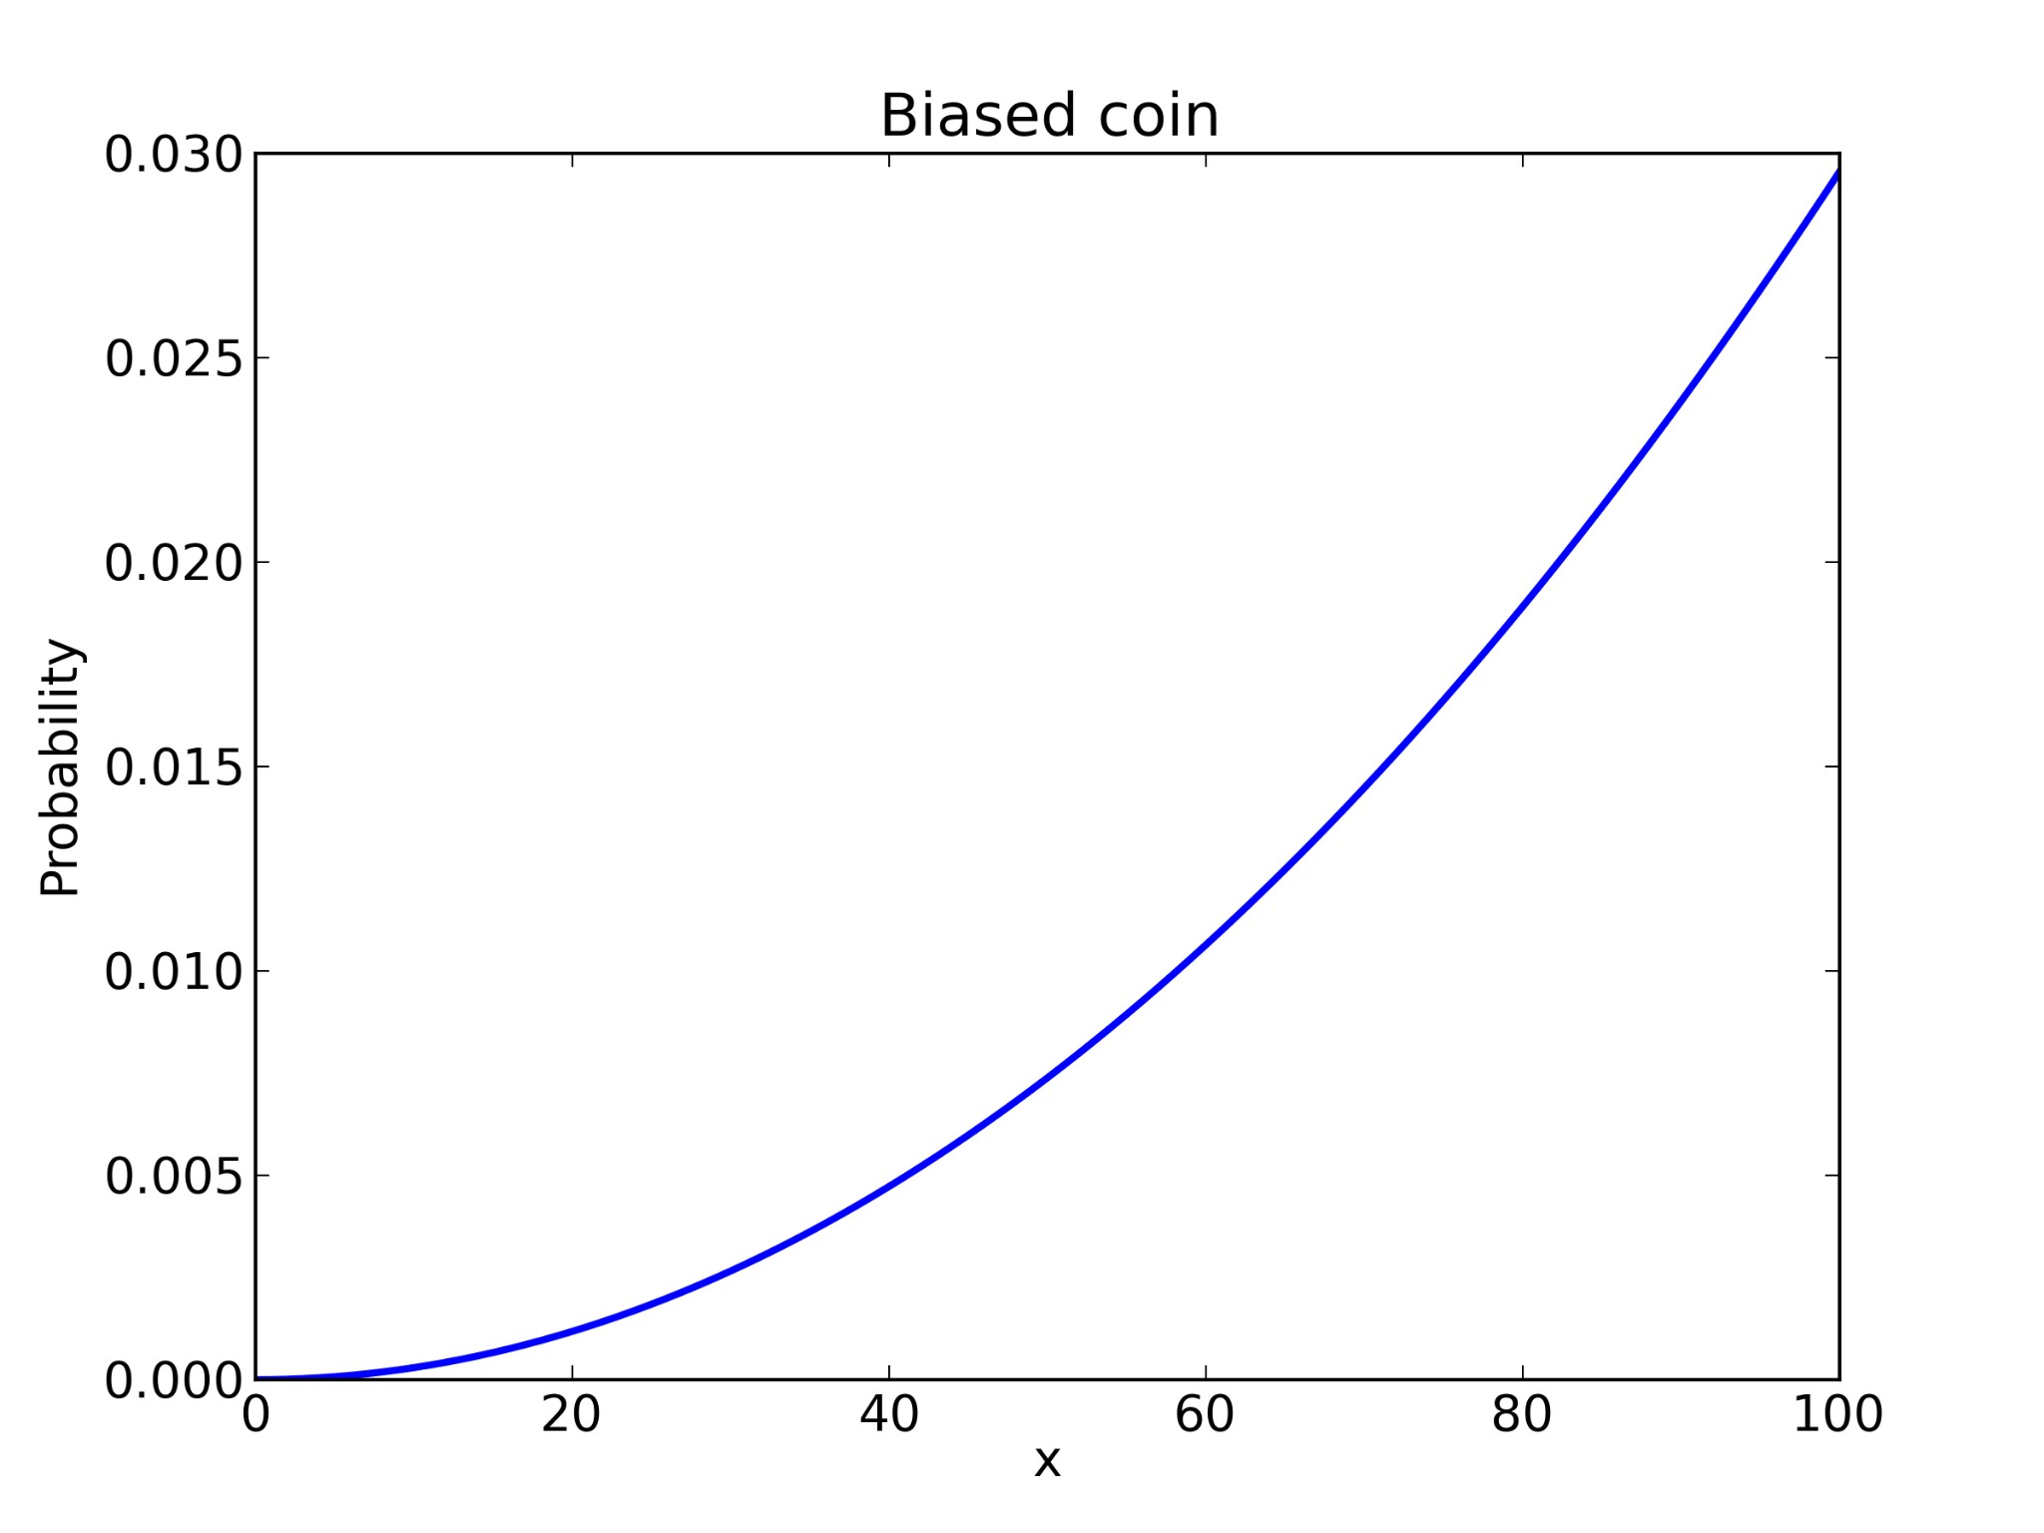

Slide 68
Update
Suppose we spin the coin again, and get tails.
suite.Update('T')
What does the posterior distribution look like?
Hint: what's p(x=100% | D)?

Slide 69
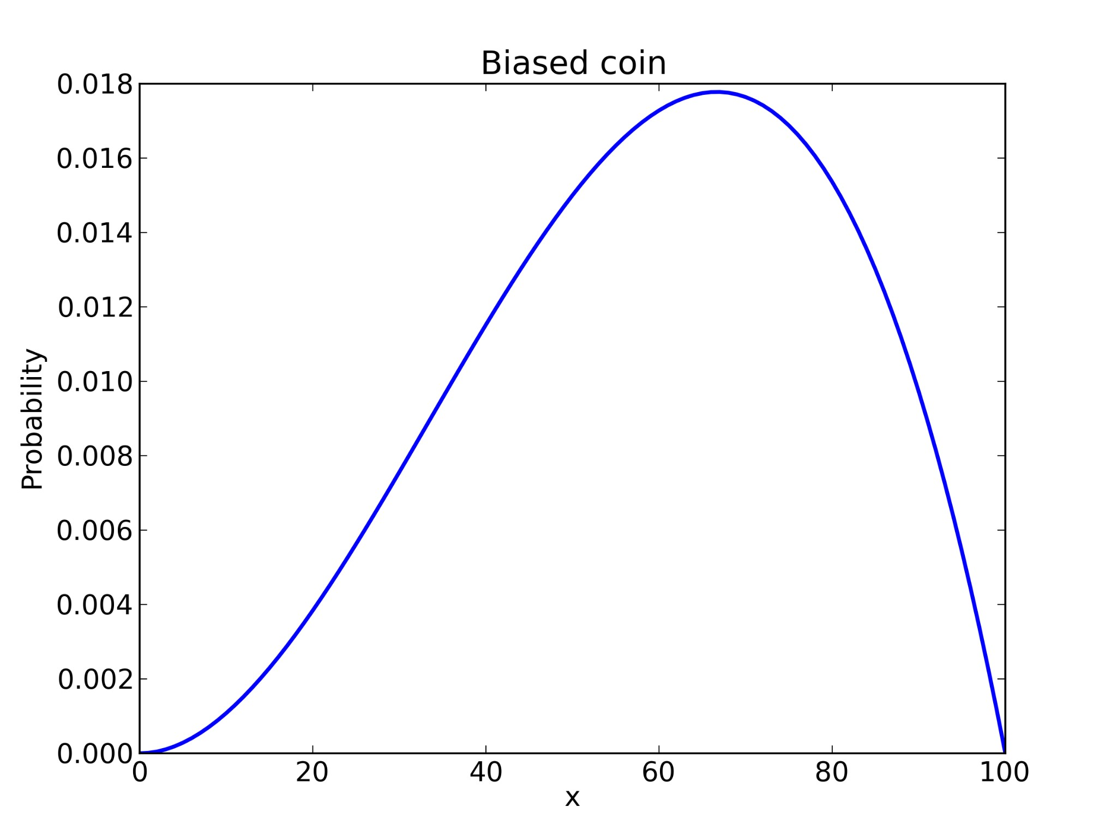

Slide 70
Update
After 10 spins, 7 heads and 3 tails:
for outcome in 'HHHHHHHTTT':
suite.Update(outcome)

Slide 71
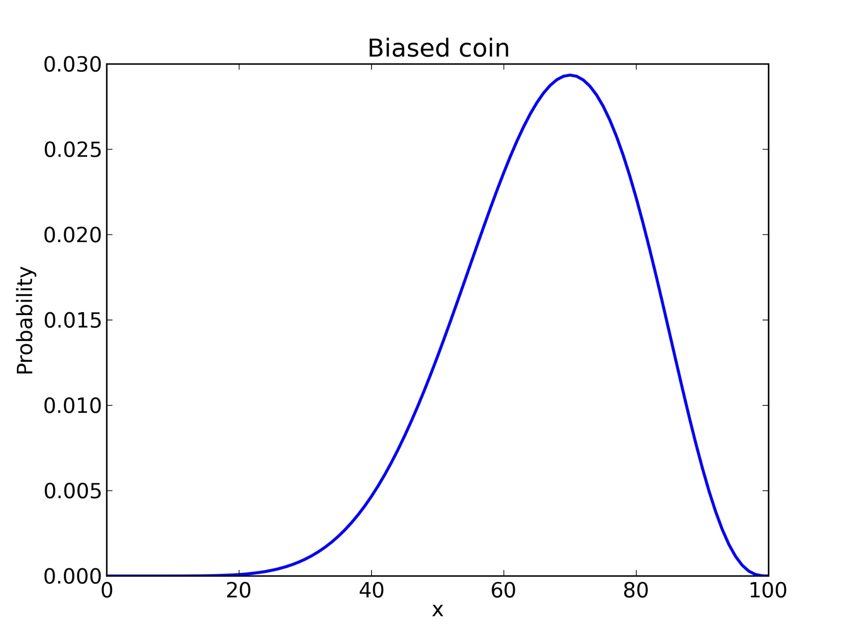

Slide 72
Update
And finally, after 140 heads and 110 tails:
evidence = 'H' * 140 + 'T' * 110
for outcome in evidence:
suite.Update(outcome)

Slide 73
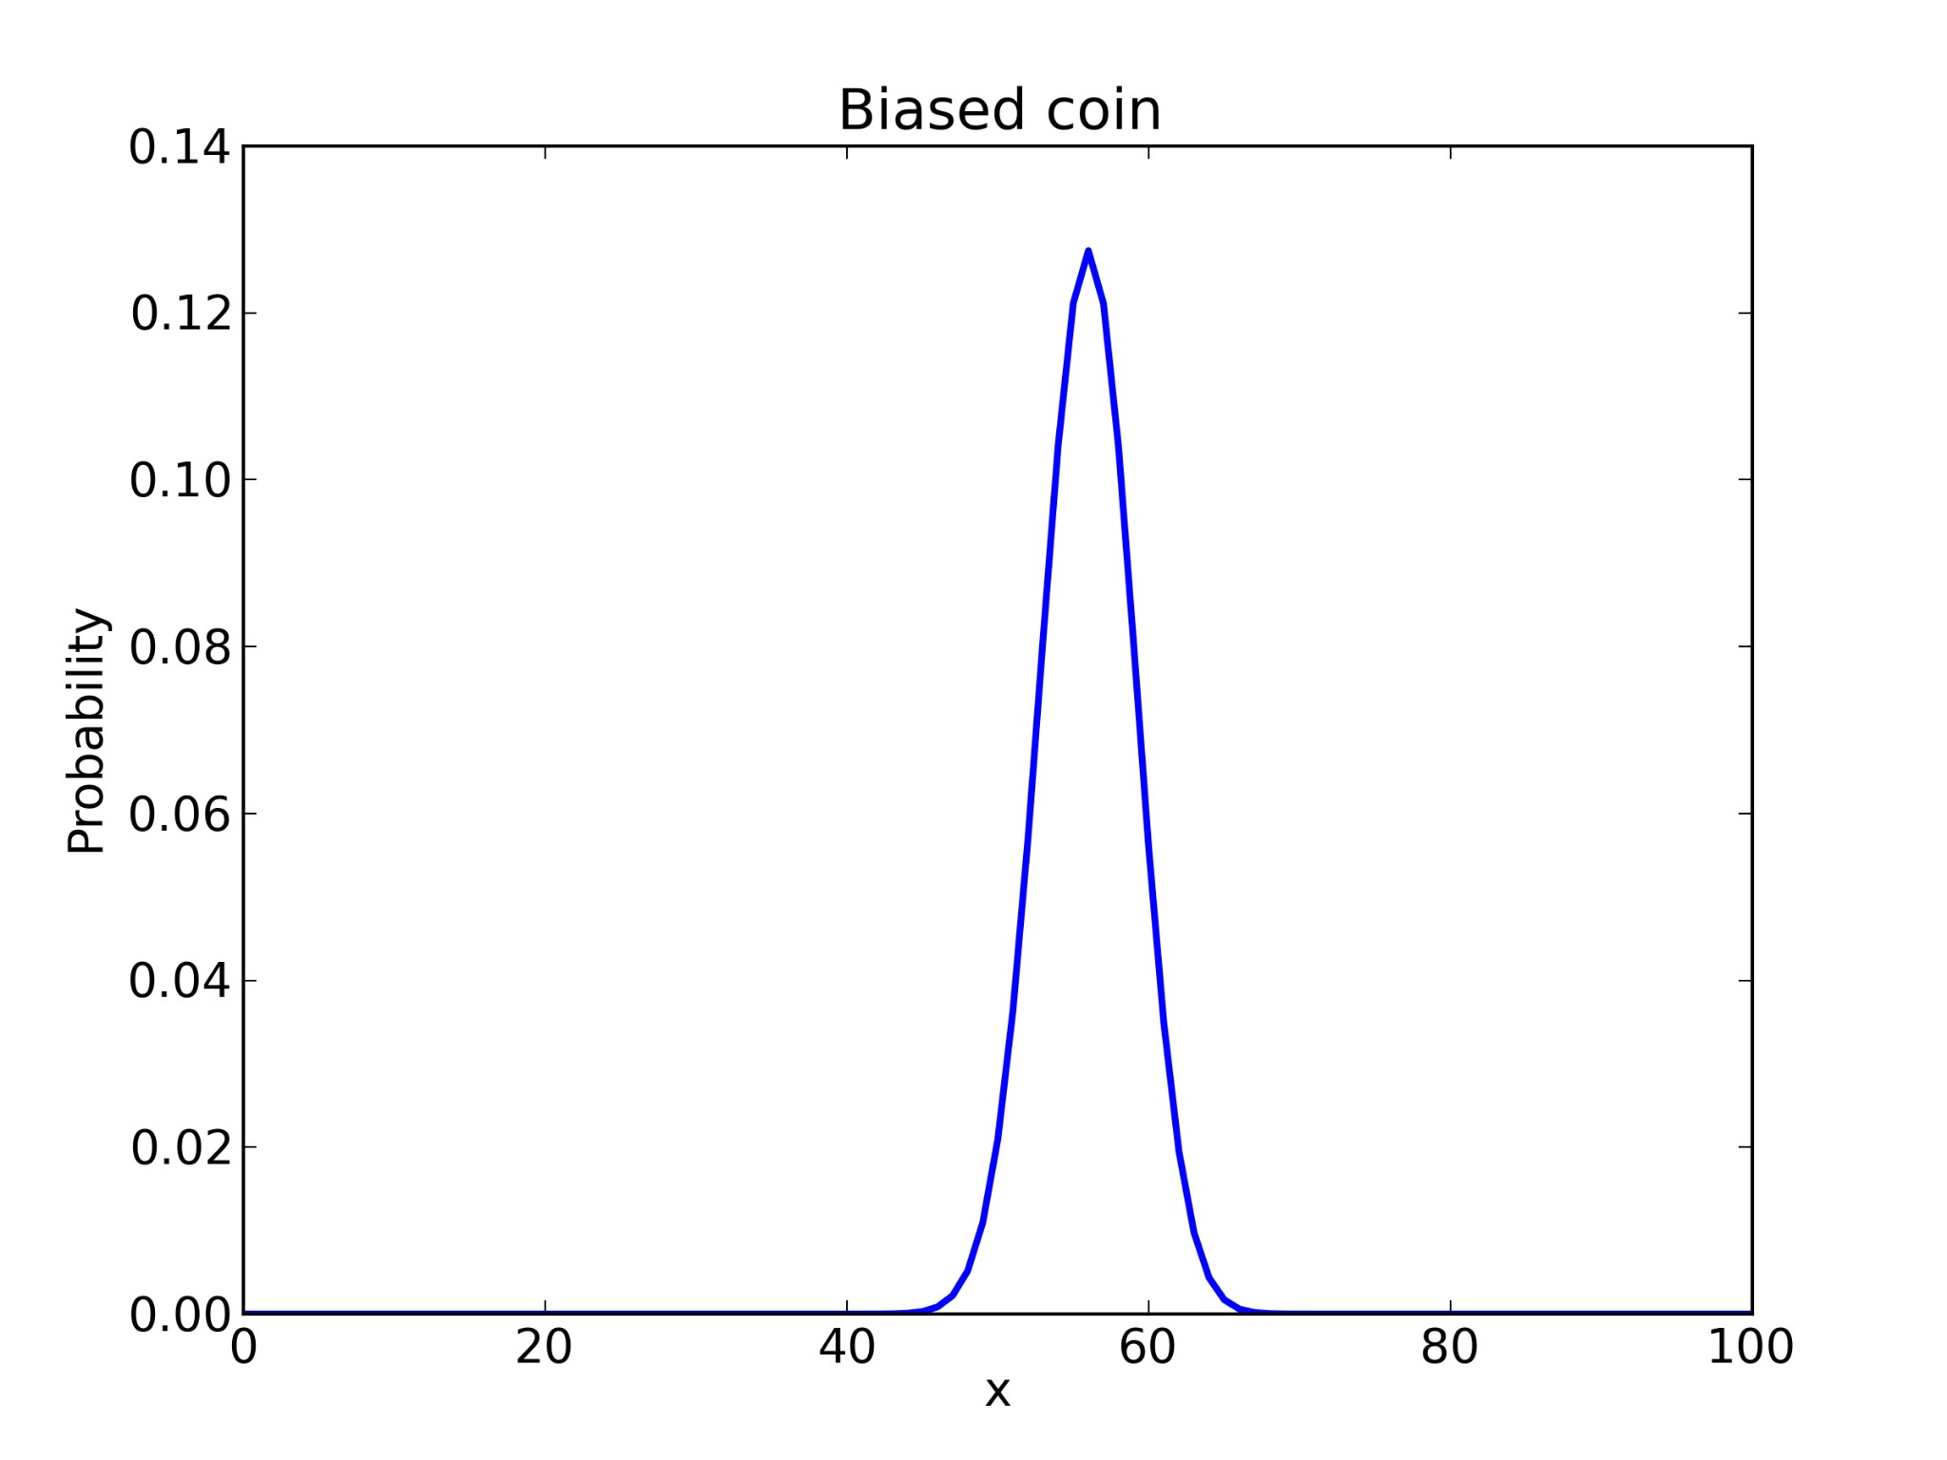

Slide 74
Posterior
Now what?
How do we summarize the information in the posterior Suite?

Slide 75
Posterior
Given the posterior distribution, what is the probability that x is 50%?
suite.Prob(50)
And the answer is... 0.021
Hmm. Maybe that's not the right question.

Slide 76
Posterior
How about the most likely value of x?
pmf.MaximumLikelihood()
And the answer is 56%.

Slide 77
Posterior
Or the expected value?
suite.Mean()
And the answer is 55.95%.

Slide 78
Posterior
Credible interval?
suite.CredibleInterval(90)

Slide 79
Posterior
The 5th percentile is 51.
The 95th percentile is 61.
These values form a 90% credible interval.
So can we say: "There's a 90% chance that x is between 51 and 61?"

Slide 80
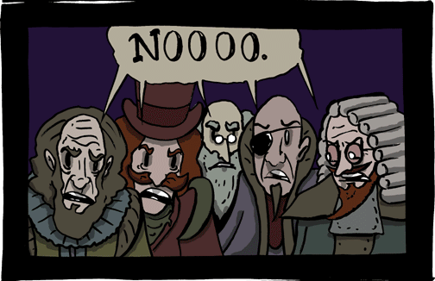
Frequentist response
Thank you smbc-comics.com

Slide 81
Bayesian response
Yes, x is a random variable,
Yes, (51, 61) is a 90% credible interval,
Yes, x has a 90% chance of being in it.
Pro: Bayesian stats are amenable to decision analysis.
Con: The prior is subjective.

Slide 82
The prior is subjective
Remember the prior?
We chose it pretty arbitrarily, and reasonable people might disagree.
Is x as likely to be 1% as 50%?
Given what we know about coins, I doubt it.

Slide 83
Prior
How should we capture background knowledge about coins?
Try a triangle prior.

Slide 84
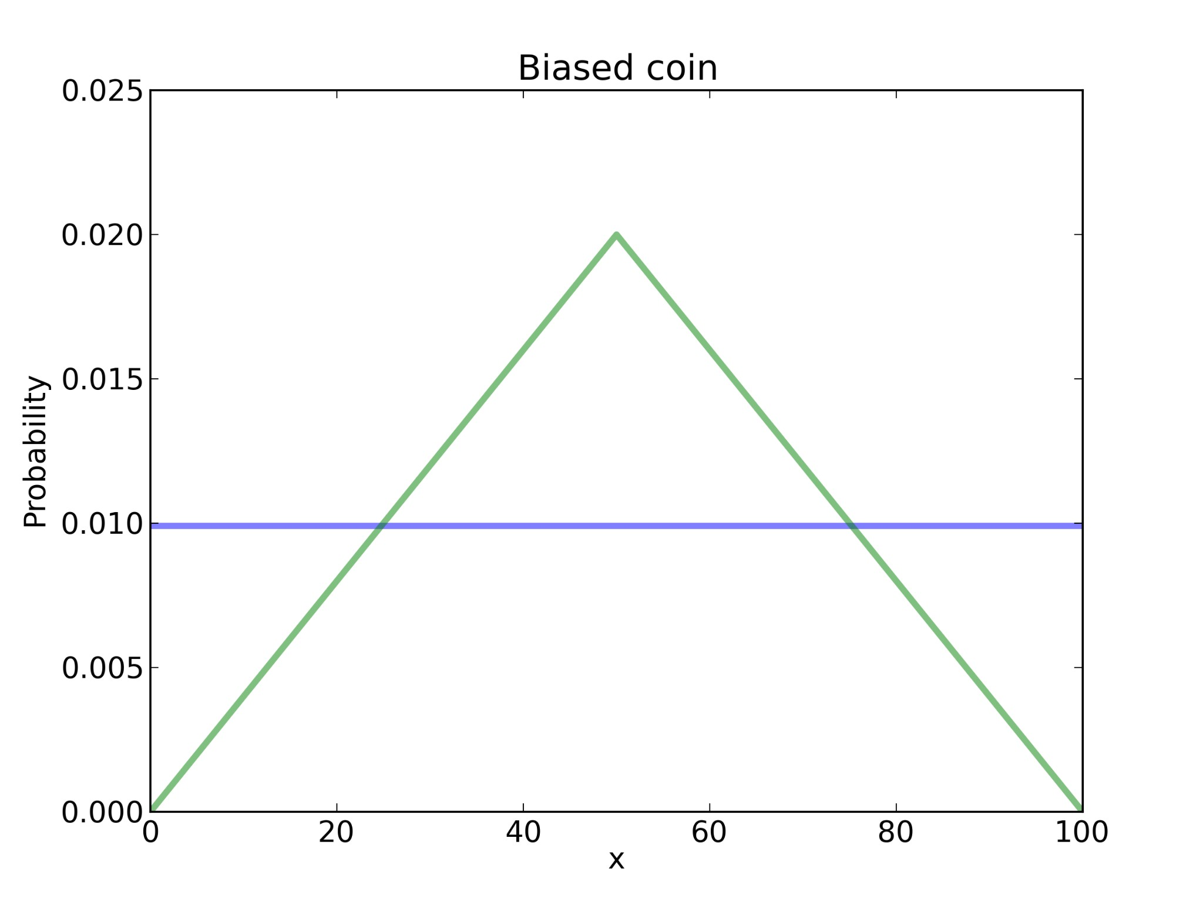

Slide 85
Posterior
What do you think the posterior distributions look like?
I was going to put an image here, but then I Googled "posterior". Never mind.

Slide 86
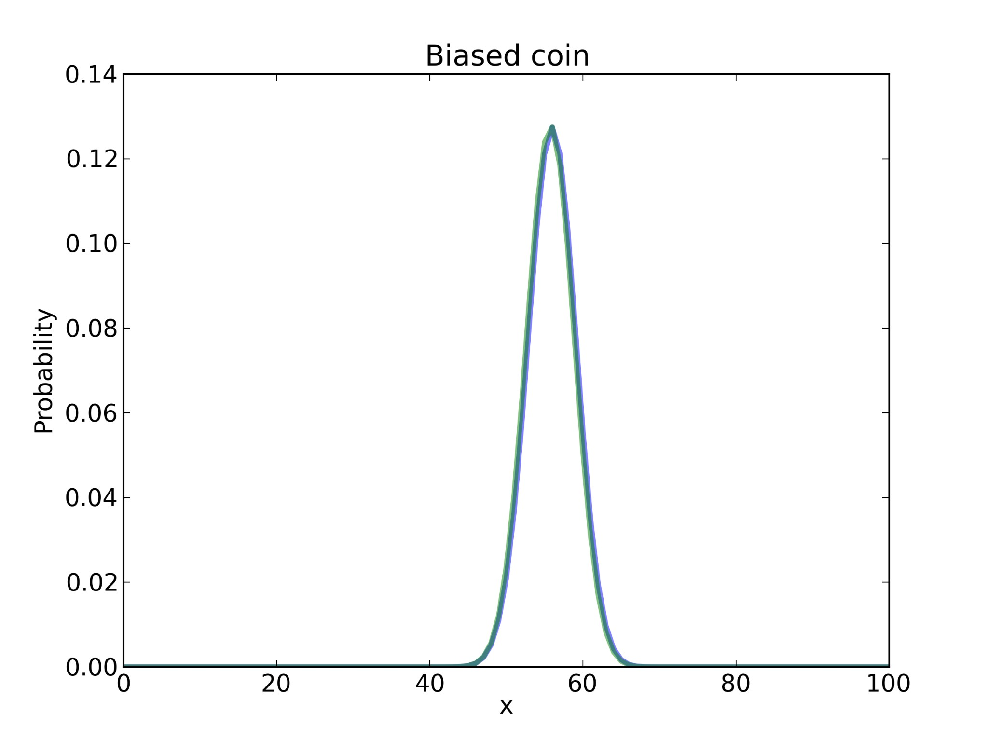

Slide 87
Swamp the prior
With enough data, reasonable people converge.
But if any p(H_{i}) = 0, no data will change that.

Slide 88
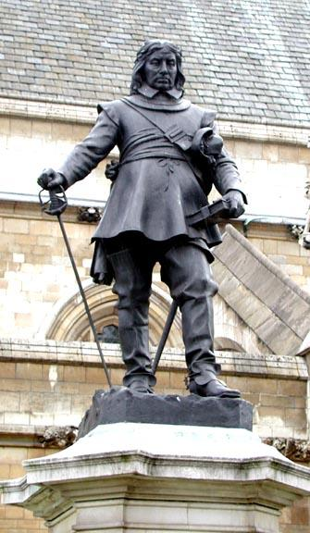
Swamp the prior
Priors can be arbitrarily low, but avoid 0.
See wikipedia.org/wiki/
Cromwell's_rule
"I beseech you, in the bowels of Christ, think it possible that you may be mistaken."

Slide 89
Summary of estimation
Form a suite of hypotheses, H_{i}.
Choose prior distribution, p(H_{i}).
Compute likelihoods, p(D|H_{i}).
Turn off brain.
Compute posteriors, p(H_{i}|D).

Slide 90

Recess!
http://images2.wikia.nocookie.net/__cb20120116013507/recess/images/4/4c/Recess_Pic_for_the_Internet.png

Slide 91
Hypothesis testing
Remember the original question:
"But do these data give evidence that the coin is biased rather than fair?"
What does it mean to say that data give evidence for (or against) a hypothesis?

Slide 92

Hypothesis testing
D is evidence in favor of H if
p(H|D) > p(H)
which is true if
p(D|H) > p(D|~H)
or equivalently if
p(D|H) / p(D|~H) > 1

Slide 93
Hypothesis testing
This term
p(D|H) / p(D|~H)
is called the likelihood ratio, or Bayes factor.
It measures the strength of the evidence.

Slide 94
Hypothesis testing
F: hypothesis that the coin is fair
B: hypothesis that the coin is biased
p(D|F) is easy.
p(D|B) is hard because B is underspecified.

Slide 95
Bogosity
Tempting: we got 140 heads out of 250 spins, so B is the hypothesis that x = 140/250.
But,
Doesn't seem right to use the data twice.
By this process, almost any data would be evidence in favor of B.

Slide 96
We need some rules
You have to choose your hypothesis before you see the data.
You can choose a suite of hypotheses, but in that case we average over the suite.

Slide 97


Slide 98
Likelihood
def AverageLikelihood(suite, data):
total = 0
for hypo, prob in suite.Items():
like = suite.Likelihood(data, hypo)
total += prob * like
return total

Slide 99
Hypothesis testing
F: hypothesis that x = 50%.
B: hypothesis that x is not 50%, but might be any other value with equal probability.

Slide 100

Prior
fair = Euro()
fair.Set(50, 1)

Slide 101

Prior
bias = Euro()
for x in range(0, 101):
if x != 50:
bias.Set(x, 1)
bias.Normalize()

Slide 102
Bayes factor
data = 140, 110
like_fair = AverageLikelihood(fair, data)
like_bias = AverageLikelihood(bias, data)
ratio = like_bias / like_fair

Slide 103
Hypothesis testing
Read euro2.py.
Notice the new representation of the data, and corresponding Likelihood function.
Run it and interpret the results.

Slide 104
Hypothesis testing
And the answer is:
p(D|B) = 2.6 · 10⁻⁷⁶
p(D|F) = 5.5 · 10⁻⁷⁶
Likelihood ratio is about 0.47.
So this dataset is evidence against B.

Slide 105
Fair comparison?
Modify the code that builds bias; try out a different definition of B and run again.
bias = Euro()
for x in range(0, 49):
bias.Set(x, x)
for x in range(51, 101):
bias.Set(x, 100-x)
bias.Normalize()

Slide 106
Conclusion
The Bayes factor depends on the definition of B.
Depending on what “biased” means, the data might be evidence for or against B.
The evidence is weak either way (between 0.5 and 2).

Slide 107
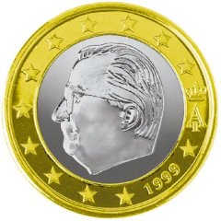
Summary
Euro problem,
Bayesian estimation,
Bayesian hypothesis testing.

Slide 108
Recess!
http://ksdcitizens.org/wp-content/uploads/2010/09/recess_time.jpg

Slide 109
Word problem for geeks
ALICE: What did you get on the math SAT?
BOB: 760
ALICE: Oh, well I got a 780. I guess that means I'm smarter than you.
NARRATOR: Really? What is the probability that Alice is smarter than Bob?

Slide 110
Assume, define, quantify
Assume: each person has some probability, x, of answering a random SAT question correctly.
Define: "Alice is smarter than Bob" means x_{a} > x_{b}.
How can we quantify Prob { x_{a} > x_{b} } ?

Slide 111

Be Bayesian
Treat x as a random quantity.
Start with a prior distribution.
Update it.
Compare posterior distributions.

Slide 112
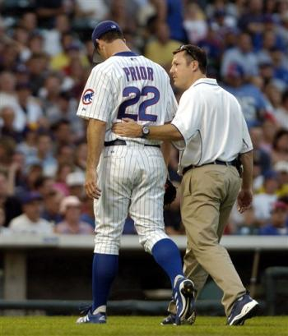
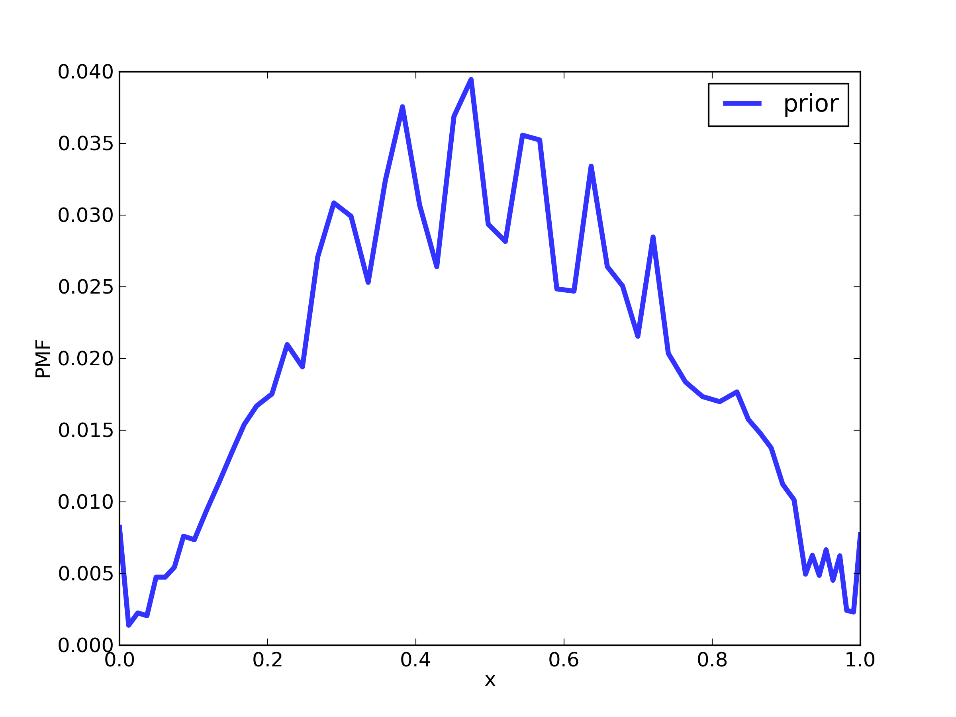
Prior?
Distribution of raw scores.

Slide 113
Likelihood
def Likelihood(self, data, hypo): x = hypo score = data raw = self.exam.Reverse(score) yes, no = raw, self.exam.max_score - raw like = x**yes * (1-x)**no return like

Slide 114
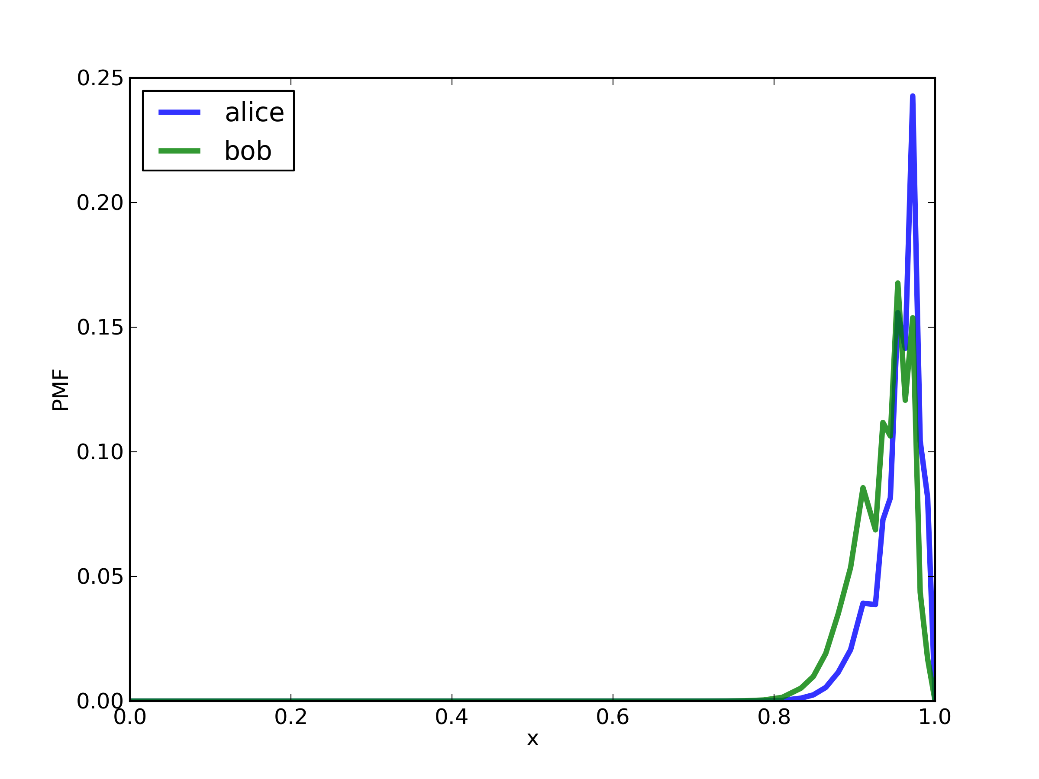
Posterior

Slide 115
PmfProbGreater
def PmfProbGreater(pmf1, pmf2):
"""Returns the prob that a value from pmf1
is greater than a value from pmf2."""

Slide 116
PmfProbGreater
def PmfProbGreater(pmf1, pmf2):
"""Returns the prob that a value from pmf1
is greater than a value from pmf2."""
Iterate through all pairs of values.
Check whether the value from pmf1 is greater.
Add up total probability of successful pairs.

Slide 117
PmfProbGreater
def PmfProbGreater(pmf1, pmf2):
for x1, p1 in pmf1.Items():
for x2, p2 in pmf2.Items():
# FILL THIS IN!

Slide 118
PmfProbGreater
def PmfProbGreater(pmf1, pmf2):
total = 0.0
for x1, p1 in pmf1.Items():
for x2, p2 in pmf2.Items():
if x1 > x2:
total += p1 * p2
return total

Slide 119

And the answer is...
Alice: 780
Bob: 760
Probability that Alice is "smarter": 61%

Slide 120
Why this example?
Posterior distribution is often the input to the next step in an analysis.
Real world problems start (and end!) with modeling.

Slide 121
Modeling
This result is based on the simplification that all SAT questions are equally difficult.
An alternative (in the book) is based on item response theory.

Slide 122
Modeling
For most real world problems, there are several reasonable models.
The best choice depends on your goals.
Modeling errors often dominate.

Slide 123
Modeling
Therefore:
Don't mistake the map for the territory.
Don't sweat approximations smaller than modeling errors.
Iterate.

Slide 124
Recess!
http://images2.wikia.nocookie.net/__cb20120116013507/recess/images/4/4c/Recess_Pic_for_the_Internet.png

Slide 125
Case study
Problem: students sign up to participate in a community service project. Some fraction, q, of the students who sign up actually participate, and of those some fraction, r, report back.
Given a sample of students who sign up and the number who report back, we can estimate the product q*r, but don't learn about q and r separately.

Slide 126
Case study
If we can get a smaller sample of students where we know who participated and who reported, we can use that to improve the estimates of q and r. And we can use that to compute the posterior distribution of the number of students who participated.

Slide 127
volunteer.py
probs = numpy.linspace(0, 1, 101) hypos = [] for q in probs: for r in probs: hypos.append((q, r)) suite = Volunteer(hypos)

Slide 128
volunteer.py
# students who signed up and reported
data = 140, 50 suite.Update(data)
# students who signed up, participated,
# and reported data = 5, 3, 1 suite.Update(data)

Slide 129
volunteer.py
class Volunteer(thinkbayes.Suite): def Likelihood(self, data, hypo): if len(data) == 2: return self.Likelihood1(data, hypo) elif len(data) == 3: return self.Likelihood2(data, hypo) else: raise ValueError()

Slide 130
volunteer.py
def Likelihood1(self, data, hypo): q, r = hypo p = q * r signed_up, reported = data yes = reported no = signed_up - reported like = p**yes * (1-p)**no return like

Slide 131
volunteer.py
def Likelihood2(self, data, hypo): q, r = hypo signed_up, participated, reported = data yes = participated no = signed_up - participated like1 = q**yes * (1-q)**no
yes = reported no = participated - reported like2 = r**yes * (1-r)**no
return like1 * like2

Slide 132
volunteer.py
def MarginalDistribution(suite, index):
pmf = thinkbayes.Pmf() for t, prob in suite.Items(): pmf.Incr(t[index], prob) return pmf

Slide 133
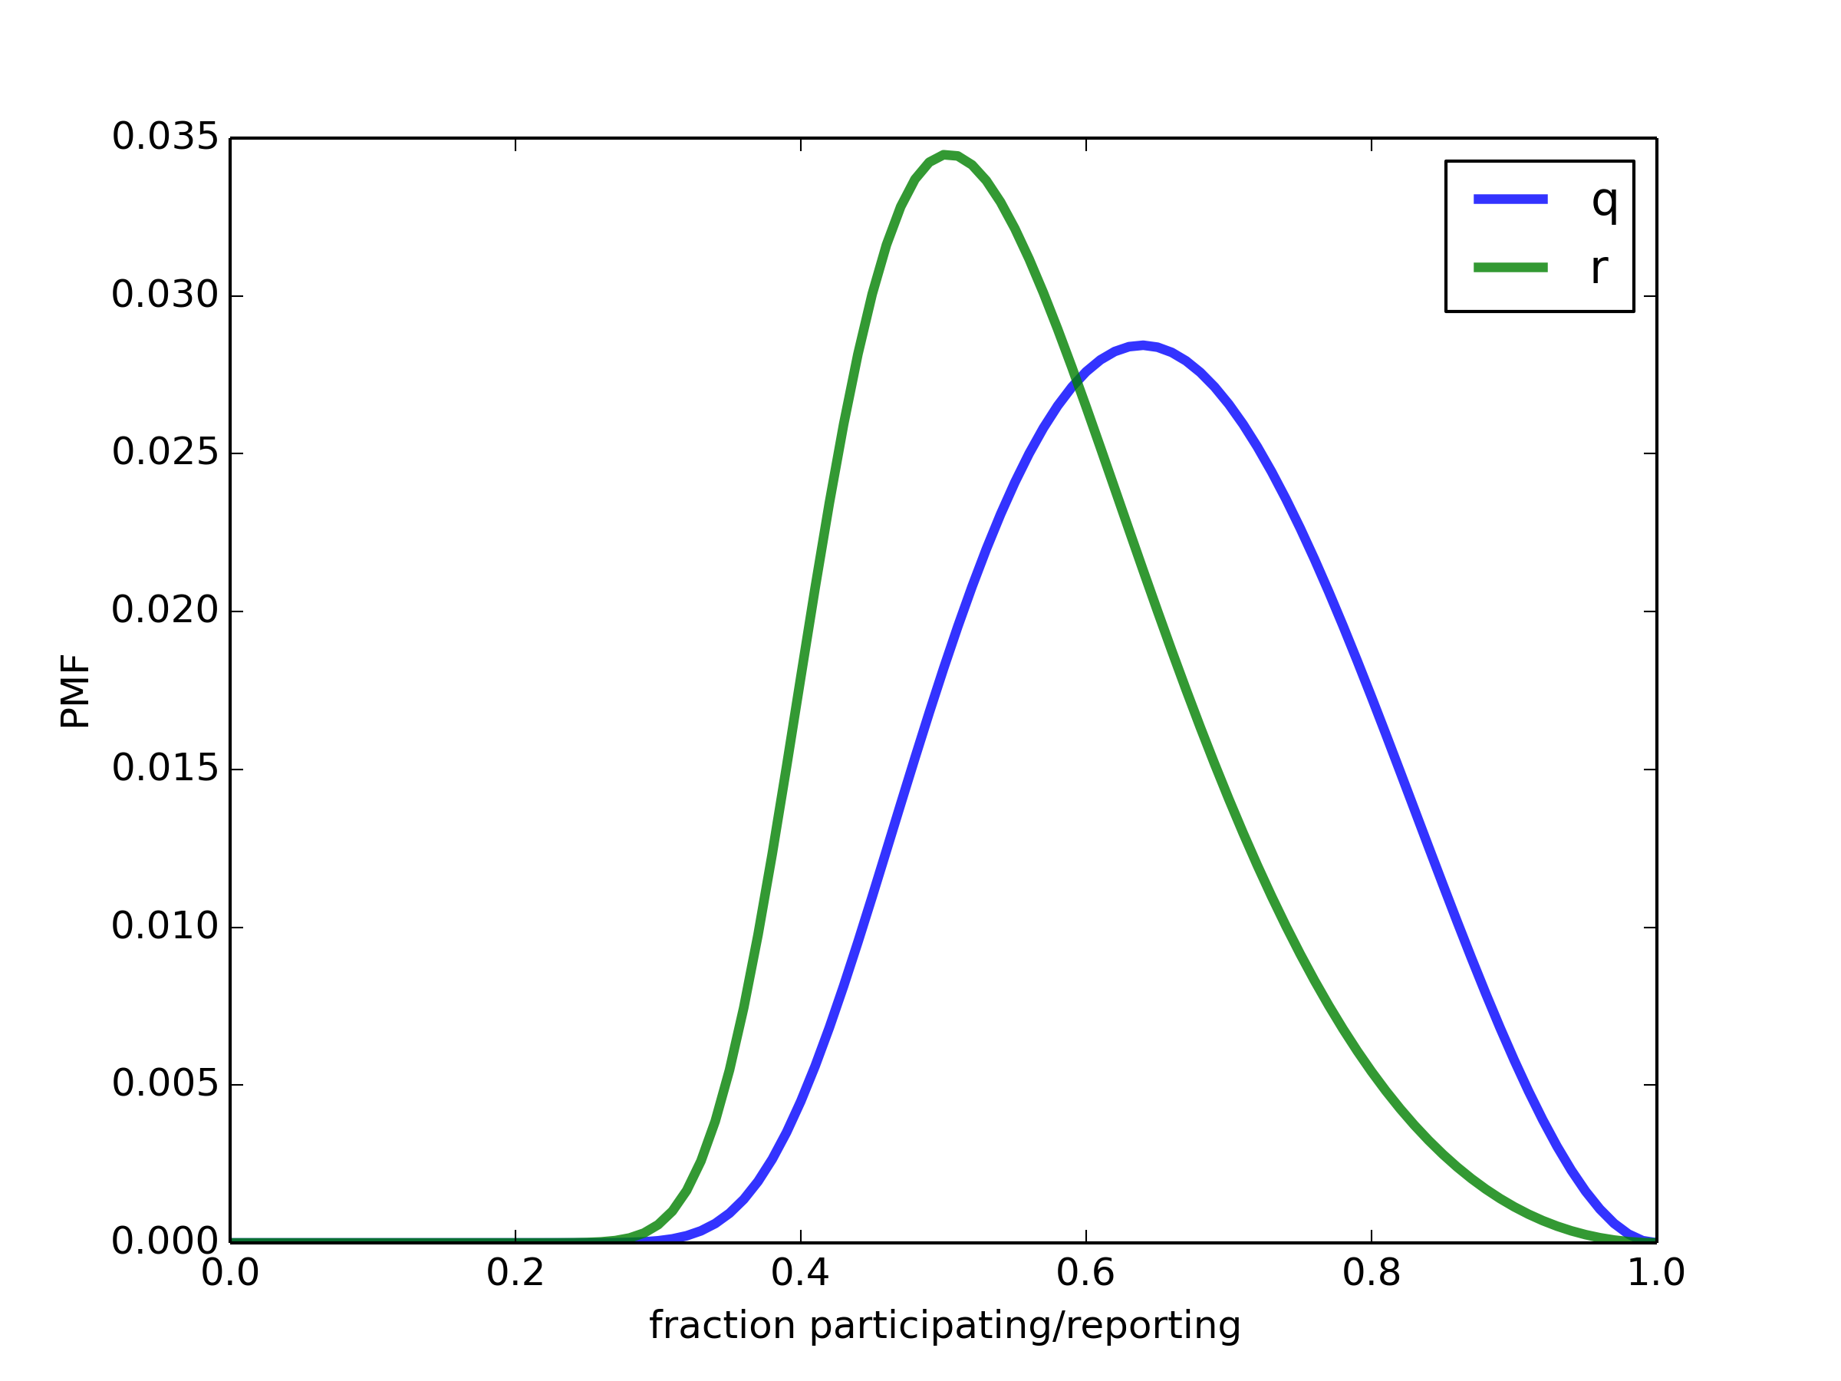

Slide 134
Summary
The Bayesian approach is a divide and conquer strategy.
You write Likelihood().
Bayes does the rest.

Slide 135
Think Bayes
This tutorial is based on my book,
Think Bayes
Bayesian Statistics Made Simple
Published by O'Reilly Media
and available under a
Creative Commons license from
thinkbayes.com

Slide 136

Case studies
Euro
SAT
Red line
Price is Right
Boston Bruins
Paintball
Variability hypothesis
Kidney tumor growth
Geiger counter
Unseen species

Slide 137
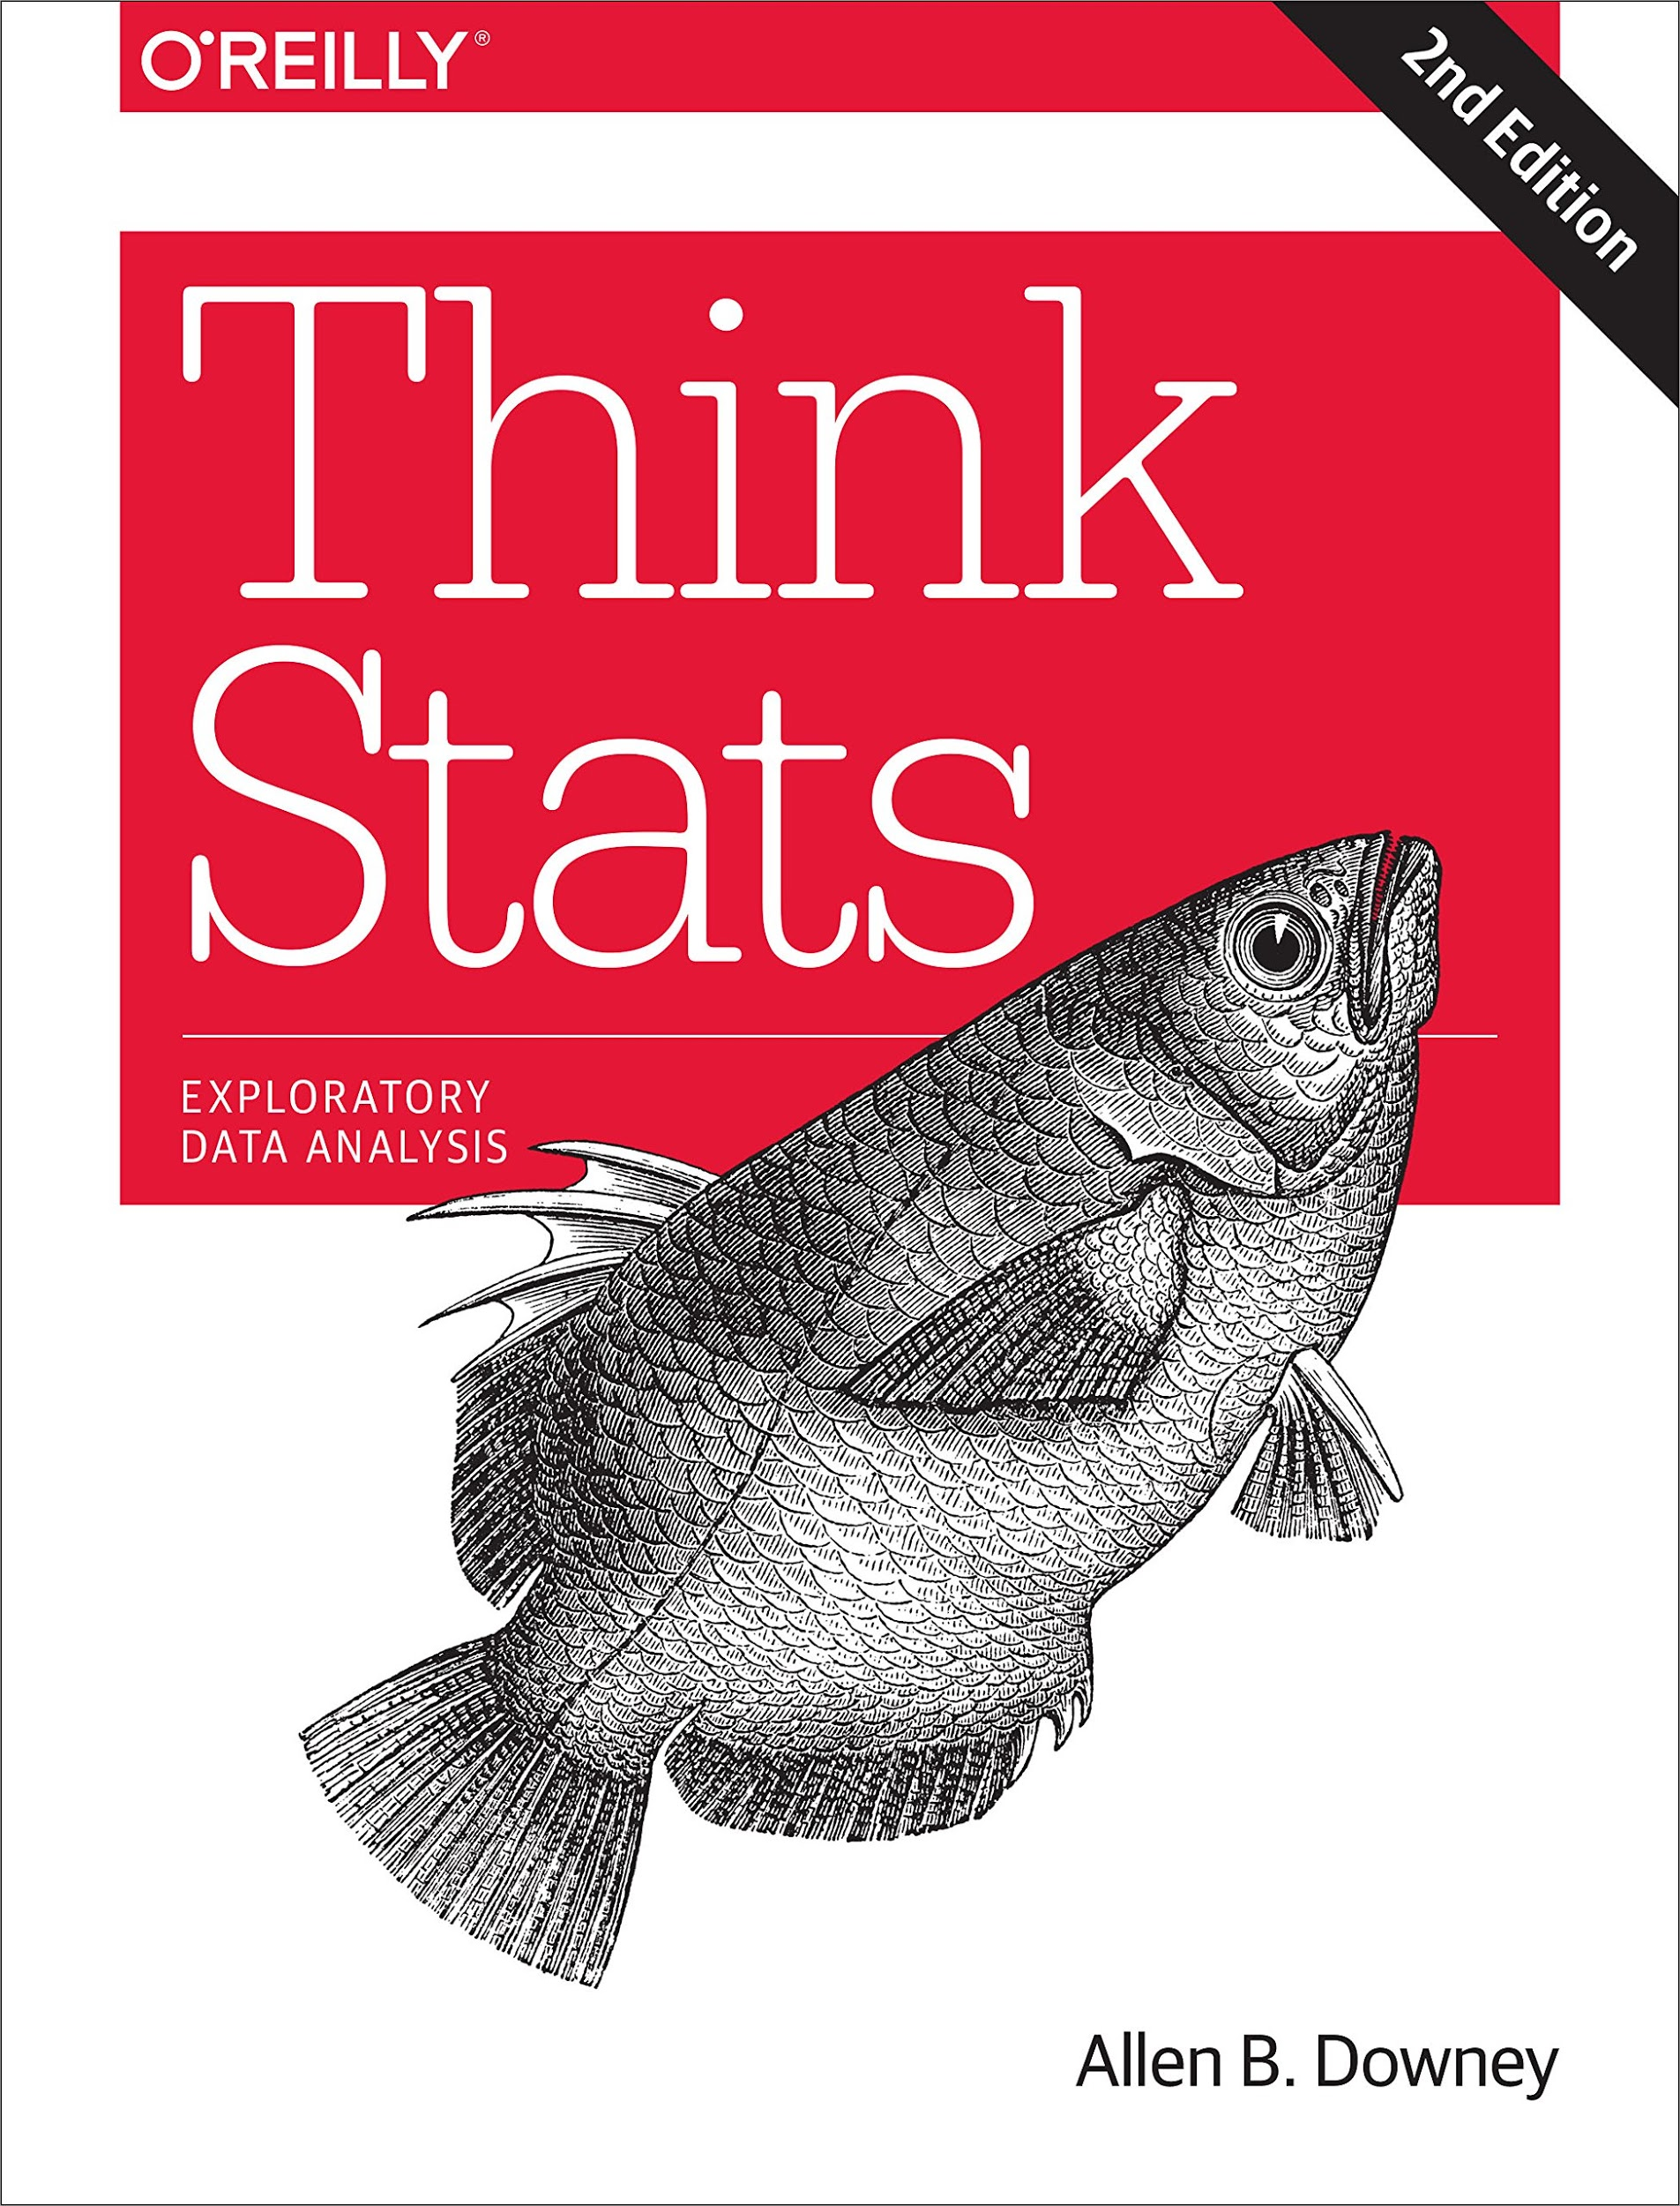
Think Stats
You might also like
Think Stats, 2nd edition
Exploratory Data Analysis
Published by O'Reilly Media
and available under a
Creative Commons license from
thinkstats2.com

Slide 138
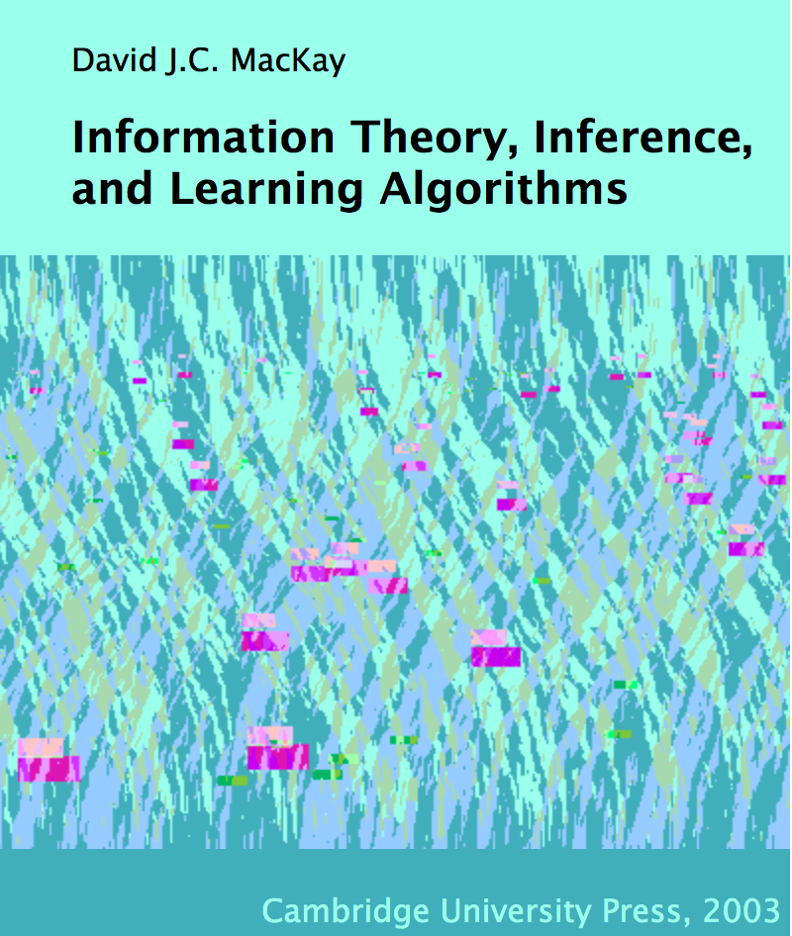
More reading
MacKay, Information Theory, Inference, and Learning Algorithms
Free PDF.

Slide 139

More reading
Davidson-Pilon,
Bayesian Methods
for Hackers
On Github.

Slide 140
More reading (not free)
Howson and Urbach, Scientific Reasoning: The Bayesian Approach
Sivia, Data Analysis: A Bayesian Tutorial
Gelman et al, Bayesian Data Analysis

Slide 141
Where does this fit?
Usual approach:
Analytic distributions.
Math.
Multidimensional integrals.
Numerical methods (MCMC).

Slide 142
Where does this fit?
Problem:
Hard to get started.
Hard to develop solutions incrementally.
Hard to develop understanding.

Slide 143
My theory
Start with non-analytic distributions.
Use background information to choose meaningful priors.
Start with brute-force solutions.
If the results are good enough and fast enough, stop.
Otherwise, optimize (where analysis is one kind of optimization).
Use your reference implementation for regression testing.

Slide 144
Need help?
I am always looking for interesting projects.
Sabbatical June 2015 to August 2016.

Slide 145
Data Science at Olin
January to May 2015.
30 students, 15 projects.
External collaborators with data and questions.
Exploratory data analysis and visualization.
Focus on health, medicine, and fitness.
sites.google.com/site/datascience15/

Slide 146

datakind.org

Slide 147


